Slide 1
AS91896(2.7) & AS91887(2.8) Monster cards
[Sudha Sutaschuto]

Slide 2
[Overtype this with your program name]
Link to GitHub Repository: https://github.com/UwUmeowmeow/2023Assessment
Links to Trello board / project management tools: [https://trello.com/b/aRzLMwFw/assessment2023]
Link to final version of your program: [here]
Ensure you have made these links ‘public’ so that they are open to anyone, including the marker. The link to your program is the final outcome of this whole project – your finished program.

Slide 3
Explain relevant Implications 1:
Additional rows can be added by clicking in the last cell and then using the Tab key
Relevant implication | Explain the implication and say how it is relevant to this project
Functionality | Functionality is about ensuring that the program work as expected. For example , if the user searched for a card, it should work as expected output like displaying the monster card names and its status. it should not crash if user input something invalid, like the user entered cards that is not in the program.
Usability | Usability, is about how easily the end user can get the program to do what it supposed to do. It deals with making instruction and error message clear and easy for user to understand. It is important to minimize or eliminate any frustration.
Aesthetics | Aesthetics is about the program’s overall appearance. A program which looks good because it includes well spaced instructions (using tabs and spaces), prompts and “decoration” around key messages is going to be more aesthetically pleasing than the one which is composed of unspread plain text.
Notes:
Additional rows can be added by clicking in the last cell and then using the Tab key

Slide 4
Describe relevant Implications 2 :
Additional rows can be added by clicking in the last cell and then using the Tab key
Relevant implication | Describe the implication and give an example
Social | The social implications of a computer program are about the affect It might have on users, the wider community, and society. It is also important to use clear, unambiguous instructions and feedback which is culturally neutral and inoffensive.
Future proofing | Future proofing is about making the program flexible and adaptable And easy to modify later if necessary. The code needs to be well set out and commented so that another programmer can make changes easily at some future time. Someone who want to modify my code in the future needs to understand the purpose and reasoning behind the different part of the code. Also, its important to use constants rather then literals- to minimize the number of places where changes have to be made.
Notes:
Additional rows can be added by clicking in the last cell and then using the Tab key

Slide 5
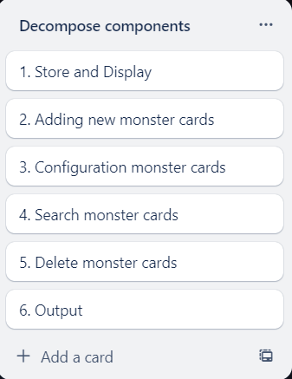
Decomposition:
Paste screenshots of your initial Trello board / task decomposition on this slide. If you have a long list, you might need to break it up into several slides.
Store all the previous Monster cards data
Display all the buttons, Adding, Edit, Search, Delete Monster cards
2. Allow user to write in inputs/details of the card, strength, speed, stealth, cunning.
3. Display button, continue and edit. If user select edit
4. Allow user to make changes to the card details and status.
5. Display an enter box for the user to enter the card name they want to search for
6. Display an enter box to user to type in the name of the card they want to delete
7. Loop the program
Notes:
Paste screenshots of your initial Trello board / task decomposition on this slide. If you have a long list, you might need to break it up into several slides.

Slide 6
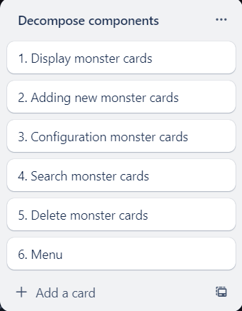
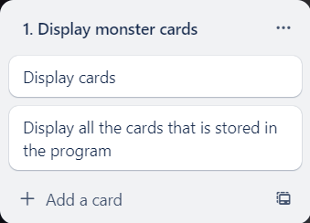
[Component 1] (Display Monster cards)

Slide 7
[Component 1- (Displaying monster cards)] - Test Plan
Additional rows can be added by clicking in the last cell and then using the Tab key
Test Cases - input | Expected output
User pressed Display button | Displayed each creature names and status
Display each creature names and status | Displayed each creature names and status
Notes:
Additional rows can be added by clicking in the last cell and then using the Tab key

Slide 8
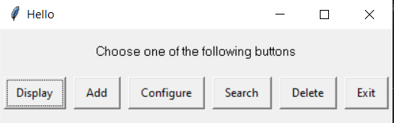
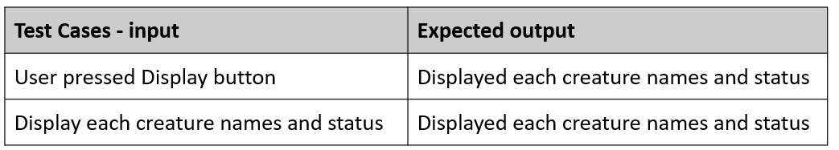
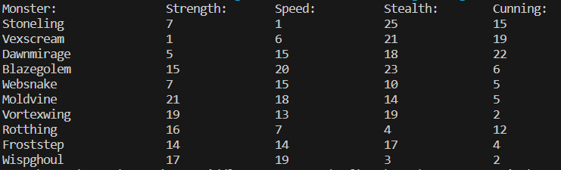
[Component 1- (Displaying monster cards)] - Test result
Additional rows can be added by clicking in the last cell and then using the Tab key
Notes:
Additional rows can be added by clicking in the last cell and then using the Tab key

Slide 9
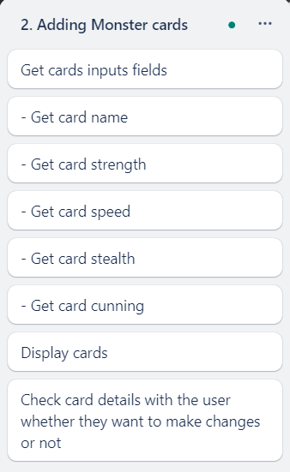
[Component 2] (Adding monster cards)

Slide 10
[Component 2- (Adding monster cards)] - Test Plan
Additional rows can be added by clicking in the last cell and then using the Tab key
Test Cases - input | Expected output
User pressed Add button | Display a multi_enterbox
Show all the fields for user to enter | Show all the fields for user to enter
If the user type invalid integer or something else other than integer | Display message box say “Please enter a valid integer for the status fields”
If the user type a number out of the range of 1- 25 | Display message box say “Please enter a integer between 1 to 25”
If the user enter nothing | Display message box say “Please enter a valid integer for the status fields”
Notes:
Additional rows can be added by clicking in the last cell and then using the Tab key

Slide 11
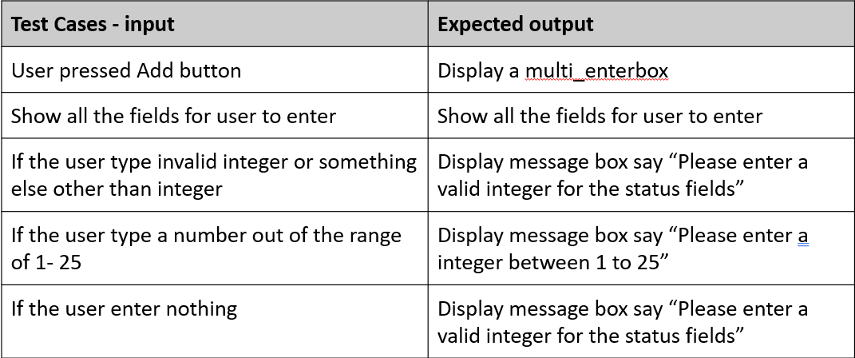
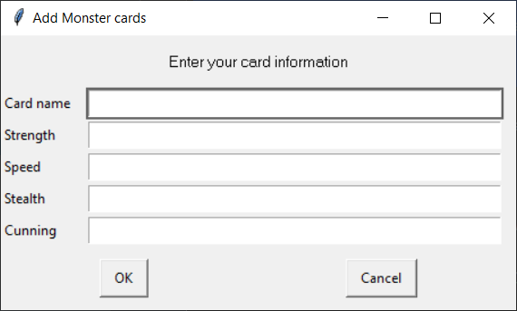
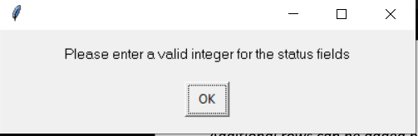
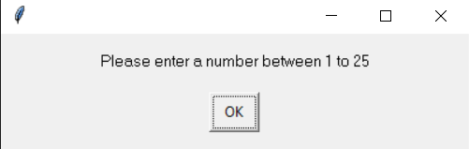
[Component 2- (Adding monster cards)] - Test result
Additional rows can be added by clicking in the last cell and then using the Tab key
Notes:
Additional rows can be added by clicking in the last cell and then using the Tab key

Slide 12
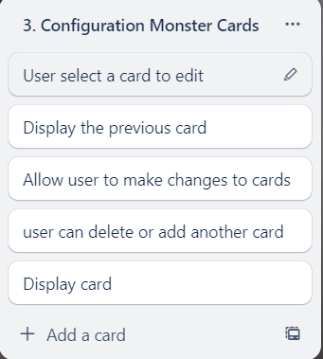
[Component 3] (Configuration Monster cards )

Slide 13
[Component 3-(Configuration Monster cards )] - Test Plan
Additional rows can be added by clicking in the last cell and then using the Tab key
Test Cases - input | Expected output
User pressed Configure button | Display an enterbox; Ask for the creature’s name
User enter the valid name | Display an enterboxes ask user for the individual fields for it status and replace it
Notes:
Additional rows can be added by clicking in the last cell and then using the Tab key

Slide 14
[Component 3-(Configuration Monster cards )] - Test result
Additional rows can be added by clicking in the last cell and then using the Tab key
Notes:
Additional rows can be added by clicking in the last cell and then using the Tab key

Slide 15
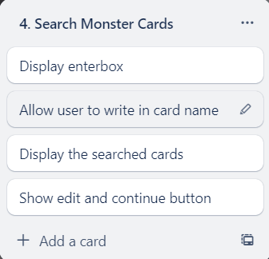
[Component 4] (Search Monster cards)

Slide 16
[Component 4- (Search Monster cards)] - Test Plan
Additional rows can be added by clicking in the last cell and then using the Tab key
Test Cases - input | Expected output
Notes:
Additional rows can be added by clicking in the last cell and then using the Tab key

Slide 17
[Component 4 - (Search Monster cards)] - Test result
Additional rows can be added by clicking in the last cell and then using the Tab key
Notes:
Additional rows can be added by clicking in the last cell and then using the Tab key

Slide 18
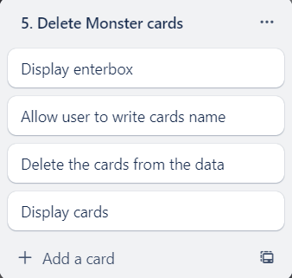
[Component 5] (Deleting Monster cards)

Slide 19
[Component 5 - (Deleting Monster cards)] - Test Plan
Additional rows can be added by clicking in the last cell and then using the Tab key
Test Cases - input | Expected output
User enter the name of monster they wanted to remove | Remove the monster
Notes:
Additional rows can be added by clicking in the last cell and then using the Tab key

Slide 20
[Component 5- (Deleting Monster cards)] - Test result
Additional rows can be added by clicking in the last cell and then using the Tab key
Notes:
Additional rows can be added by clicking in the last cell and then using the Tab key

Slide 21
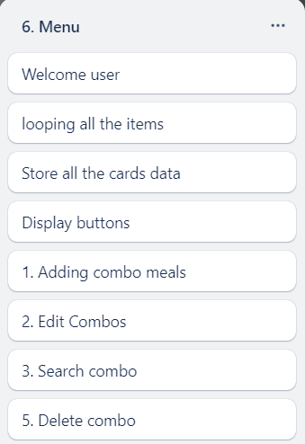
[Component 6] (Menu)

Slide 22
[Component 6 - (Menu)] - Test Plan
Additional rows can be added by clicking in the last cell and then using the Tab key
Test Cases - input | Expected output
Notes:
Additional rows can be added by clicking in the last cell and then using the Tab key

Slide 23
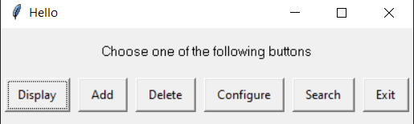
[Component 6 - (Menu)] - Test result
Additional rows can be added by clicking in the last cell and then using the Tab key
Notes:
Additional rows can be added by clicking in the last cell and then using the Tab key

Slide 24
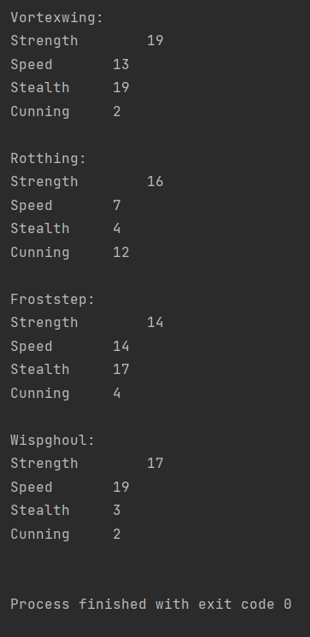
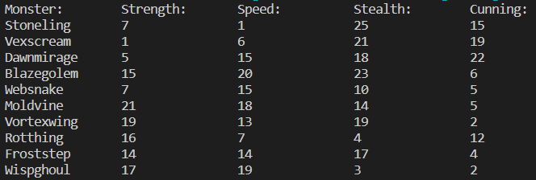
Display Monster cards : Trialling 1
Trial 1
Trial 2
Notes:
NOTE: Trialling needs to happen for at least 2 of your components but is not necessary for ALL components.
Trialling is not the same as testing. Trialling is about finding different ways of building the same component. Show evidence of your trialling here. Select one of your trials for further development and give reasons for your choice.

Slide 25
Store and Display Monster cards - Trialling
NOTE: Trialling needs to happen for at least 2 of your components but is not necessary for ALL components.
Trialling is not the same as testing. Trialling is about finding different ways of building the same component. Show evidence of your trialling here. Select one of your trials for further development and give reasons for your choice.
Trial 1(Monster Cards Display v1) – Display all the cards to the user
Trial 2(Monster Cardsv2 Display v2) – Display all the cards to the user with column using tabs (/t)
Both trials could be easily put into a recyclable function, although the trials 1 use slightly less code but the trials 2 code is more efficient, the output code is well structured and easier to read since trails 1output character is too long and it exceeds the boundary at the bottom, so user need to scroll down which make it less efficient.
Consequently, that is why I have chosen to further develop trial 2 version for integration into my final program.
Notes:
NOTE: Trialling needs to happen for at least 2 of your components but is not necessary for ALL components.
Trialling is not the same as testing. Trialling is about finding different ways of building the same component. Show evidence of your trialling here. Select one of your trials for further development and give reasons for your choice.

Slide 26
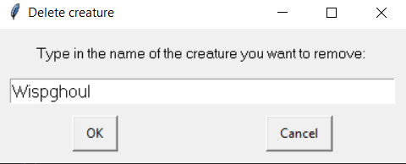
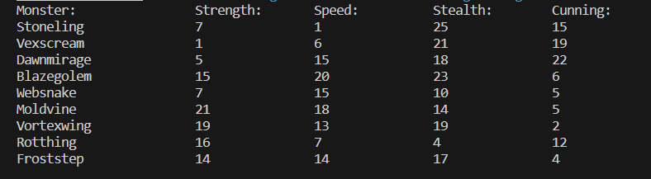
Delete Monster cards: Trialling 2
Trial 1
Notes:
NOTE: Trialling needs to happen for at least 2 of your components but is not necessary for ALL components.
Trialling is not the same as testing. Trialling is about finding different ways of building the same component. Show evidence of your trialling here. Select one of your trials for further development and give reasons for your choice.

Slide 27
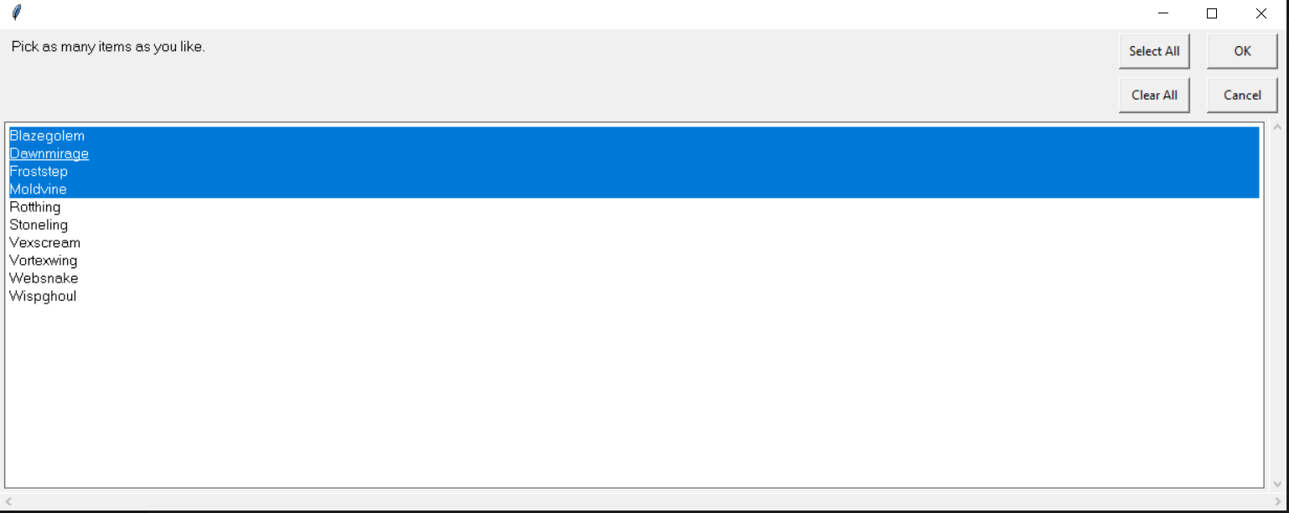
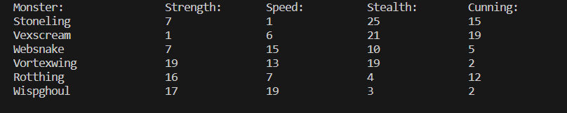
Delete Monster cards: Trialling 2
Trial 2
Notes:
NOTE: Trialling needs to happen for at least 2 of your components but is not necessary for ALL components.
Trialling is not the same as testing. Trialling is about finding different ways of building the same component. Show evidence of your trialling here. Select one of your trials for further development and give reasons for your choice.

Slide 28
Delete Monster cards - Trialling
NOTE: Trialling needs to happen for at least 2 of your components but is not necessary for ALL components.
Trialling is not the same as testing. Trialling is about finding different ways of building the same component. Show evidence of your trialling here. Select one of your trials for further development and give reasons for your choice.
Trial 1(Deletingv1)- Delete the individual card that user typed the name in using the enterbox
Trial 2(Deleting v2) – Delete the individual card or multiple cards that user have selected. Using the multi_enterbox
Both trials could be easily put into a recyclable function, Trial 1 can only delete one creature at a time and the user need to remember the card name to type it in the box and it need to be type in correctly or the program will terminate, but trail 2 user doesn’t need to remember the card name and user can select to delete multiple cards at once
Trial 2 is better because it reduces the error that can be made from the user because user can just select the existing card name and delete it manually or by selecting all of it, trial 1 user need to type in the name correctly and get all the capital right or it wouldn’t find the card, therefore trial will cause less error
Consequently, that is why I have chosen to further develop trial 2 version for integration into my final program.
Notes:
NOTE: Trialling needs to happen for at least 2 of your components but is not necessary for ALL components.
Trialling is not the same as testing. Trialling is about finding different ways of building the same component. Show evidence of your trialling here. Select one of your trials for further development and give reasons for your choice.

Slide 29
Assembled Outcome Testing:
Show testing for your assembled outcome below. This should include a test plan followed by screenshot proof.
Notes:
Show testing for your assembled outcome below. This should include a test plan followed by screenshot proof.

Slide 30
Address relevant Implications:
Relevant implication | Explain how your final outcome addresses each implication

Slide 31
Version Control Evidence:
Your version control evidence should go here. This could be in the form of screenshots (both of your GitHub repository as well as your local project folder) as evidence of your incremental development.
Notes:
Your version control evidence should go here. This could be in the form of screenshots (both of your GitHub repository as well as your local project folder) as evidence of your incremental development.

Slide 32
Final Discussion:
Discuss how the information from planning, testing and trialling of components assisted in the development of a high-quality outcome.
Notes:
Discuss how the information from planning, testing and trialling of components assisted in the development of a high-quality outcome.

Slide 33
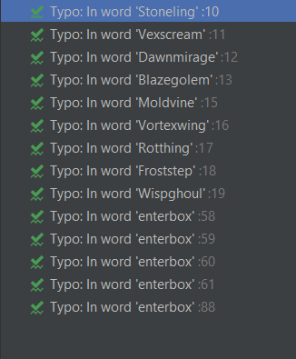

Evidence of meeting PEP8 requirements
All the code meets the pep8 standard. The green problem are just spelling mistake from the creature's name

